Slide 1
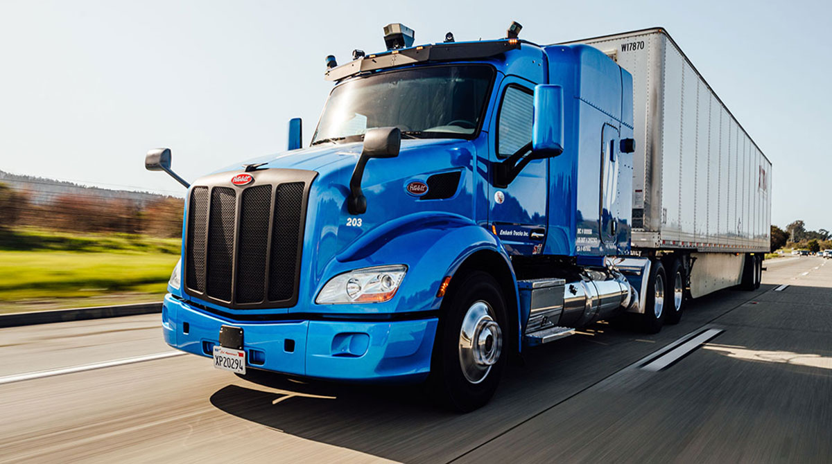
GPS Tracker for Supply Chain Logistics
Group Members
Ozogu Tolumoyi
Jeeva Sam
Harshitha Konduru

Slide 2
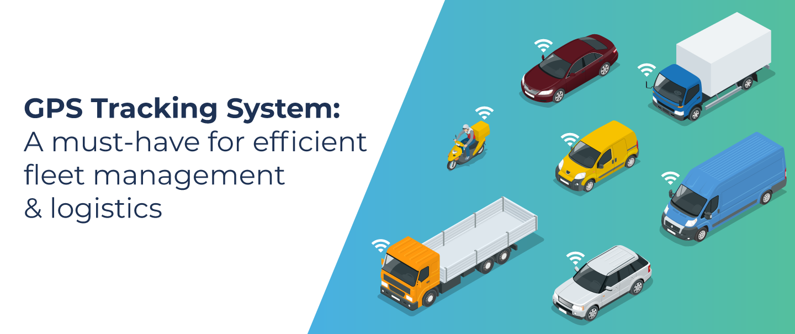
Problems faced by fleet managers without a GPS tracking system.

Slide 3

Problems faced by fleet managers without a GPS tracking system.
Delay in communicating and sending help in case of malfunction or accident
Malpractices, rerouting, and unwanted stoppages go unnoticed at times.
It leads to poor route planning due to a lack of historical trip data.
The poor mental health of Fleet Managers

Slide 4

Goal of our Project
Provide A user friendly GPS tracking system to the fleet managers by providing the following:
Getting the location as sms on phone.
Real Time data acquisition by connecting it to the database

Slide 5
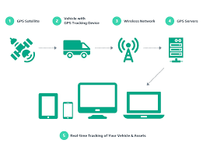
Process involved
Building the GPS tracking system
Collecting the Data

Slide 6
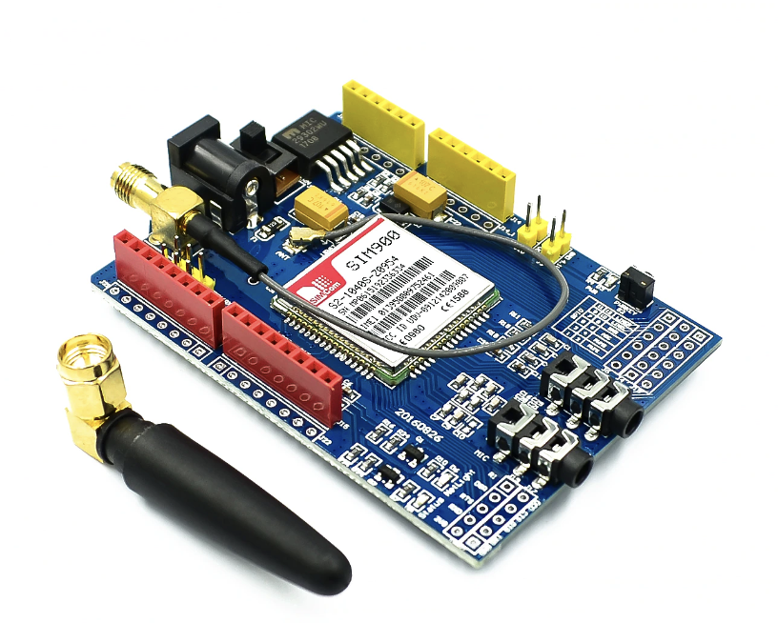
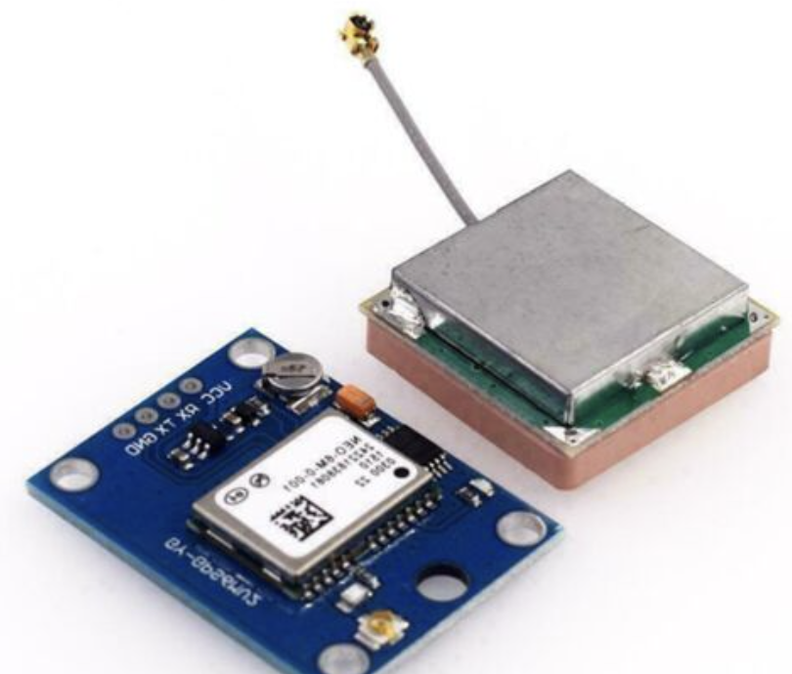
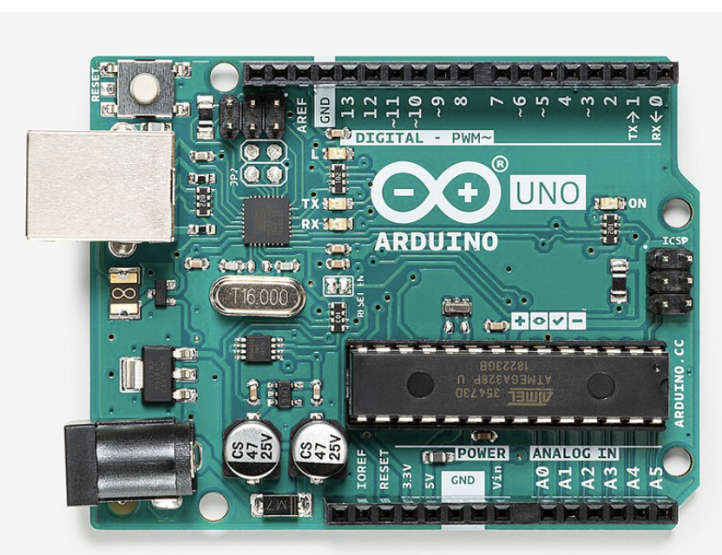
Components Used
Arduino Uno
GSM Sim 900
GPS Module

Slide 7
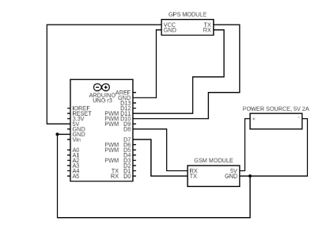
Building the GPS tracking system

Slide 8
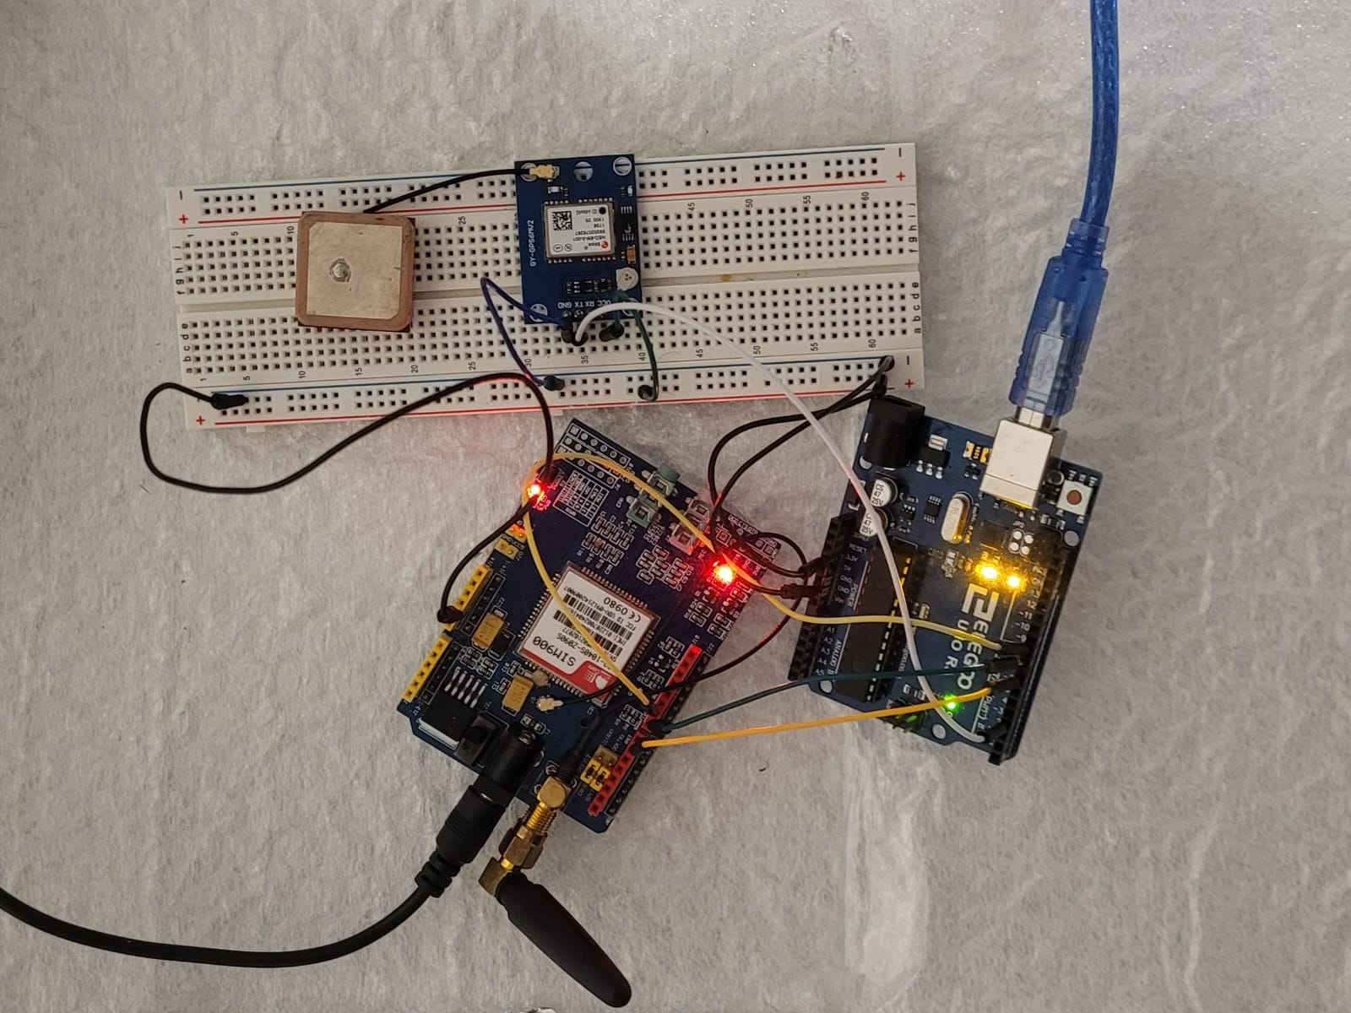

Slide 9
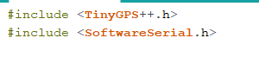
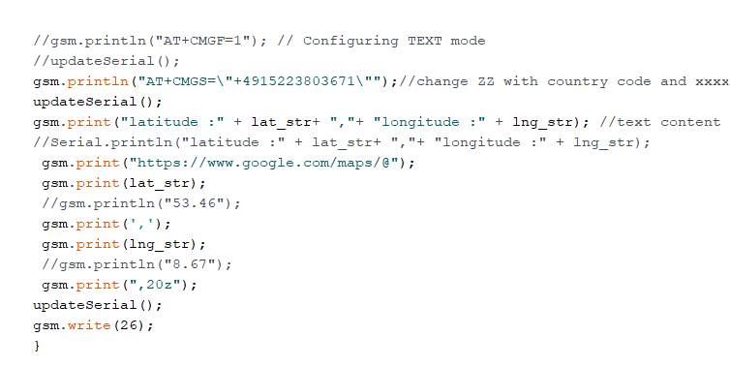
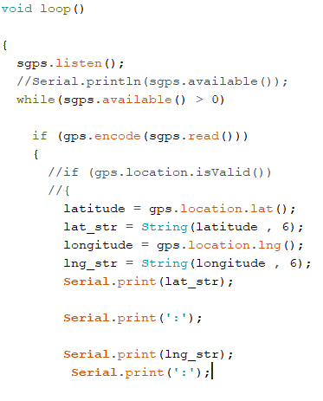
Arduino Codes for Integrating GPS and GSM

Slide 10
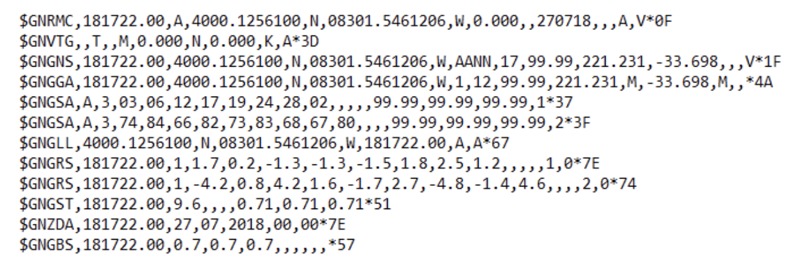
GPS NMEA Data

Slide 11
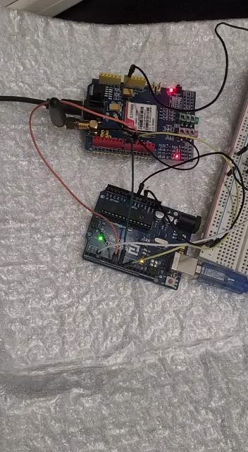
Demo Video

Slide 12
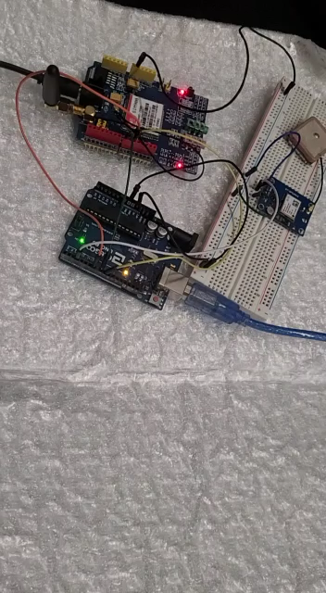
Demo Video

Slide 13
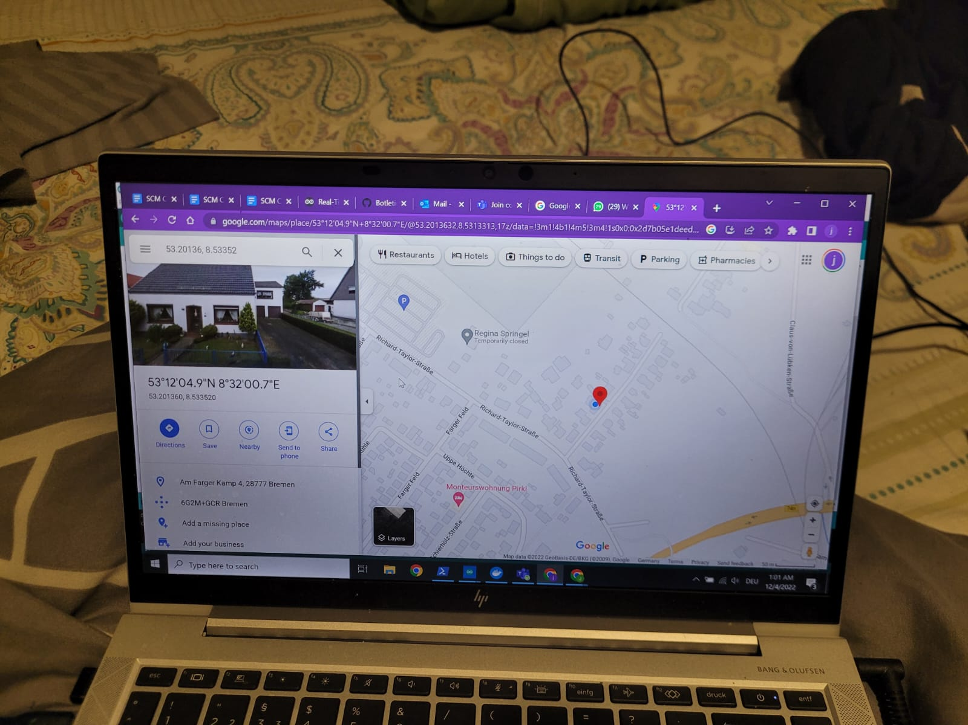
The results
Just Knowing the latitude and longitude through google maps

Slide 14
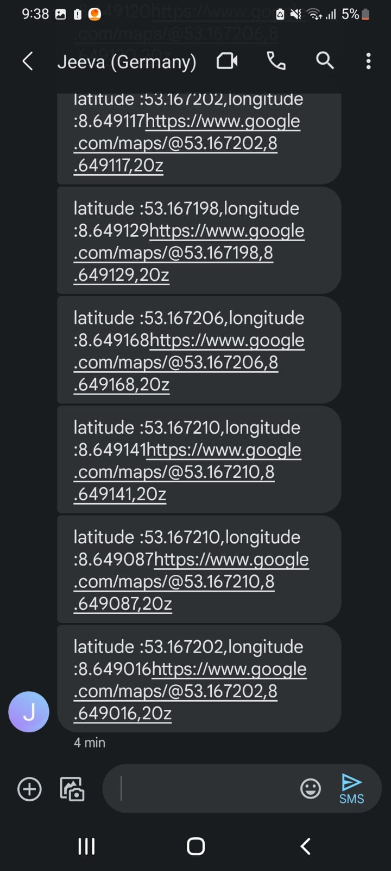
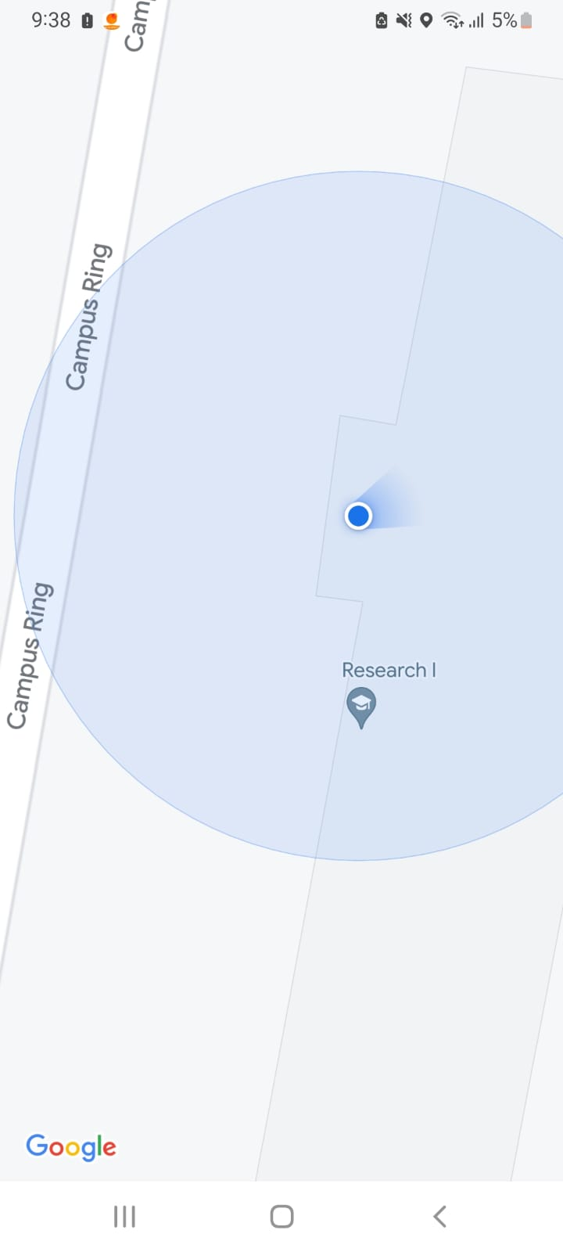
On the phone

Slide 15
DATA ACQUISITION
Connected the arduino to python using pip install pyserial.
Connected to Google cloud for accumulating real time data
And Connected to mysql to obtain the database which is deployed in PHPmy Admin

Slide 16
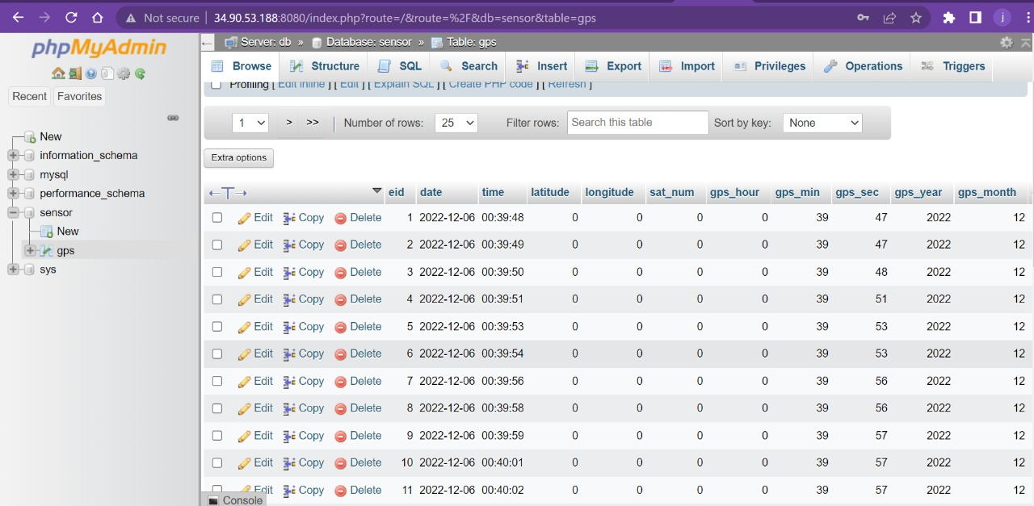
Results

Slide 17
Challenges we faced
GPS module was not actively getting synchronised with satellites so to improvise the connection it took time.
We went through a short circuit due to external adapter source which was given to GSM module..

Slide 18
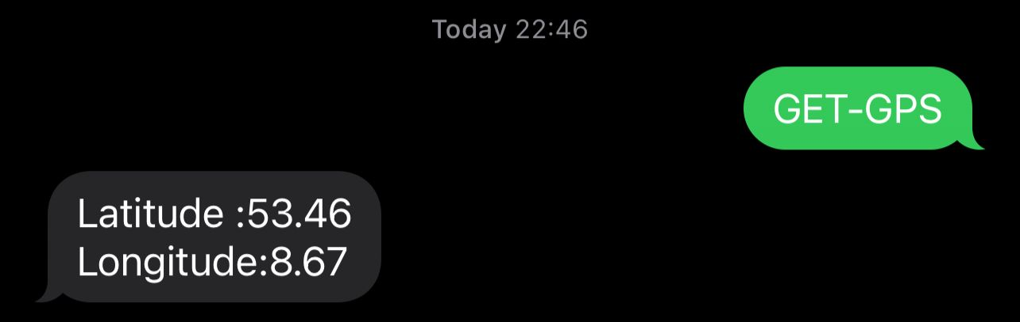
Future scope

Slide 19
Thank You

